Slide 1
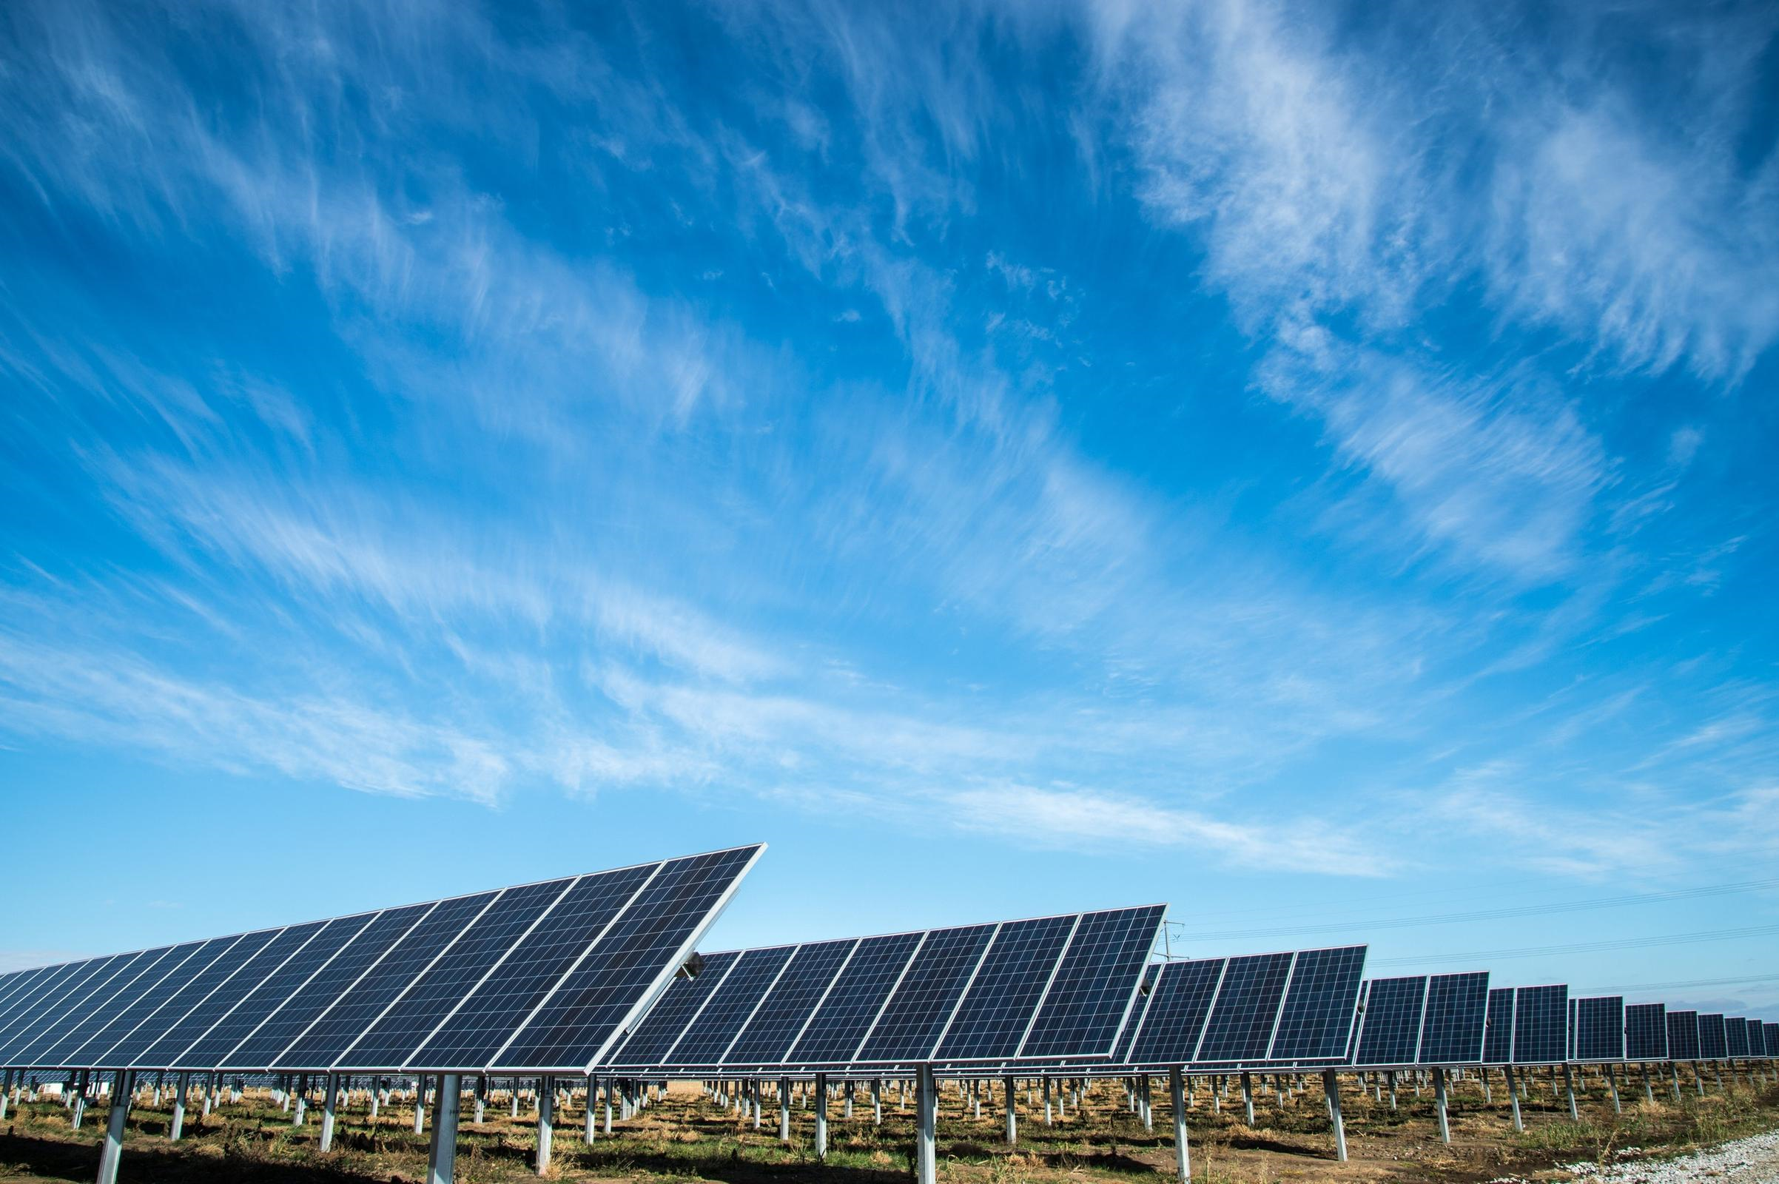
Team Zero
Amin Mansouri
Jefry el Bhwash
Niels van Schaik
Niels van Drunen
Levy Duivenvoorden

Slide 2
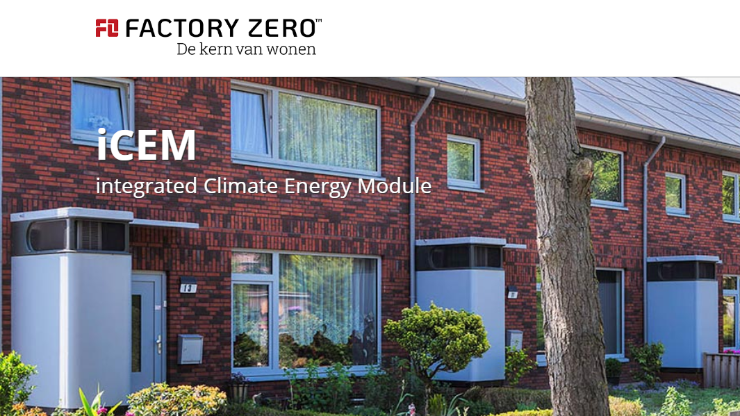
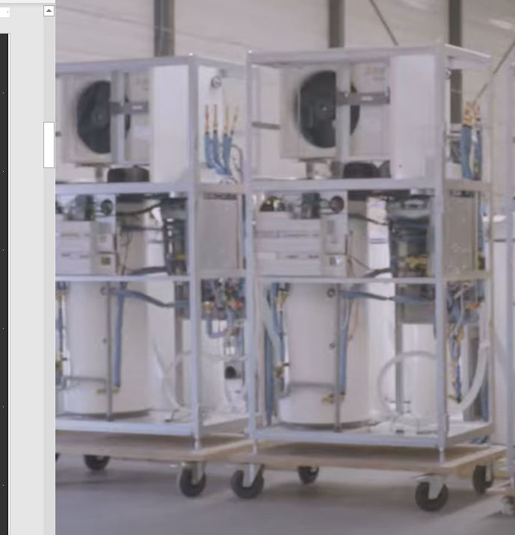
120 houses located in Zoetermeer

Slide 3
Research Question
What is a suitable machine learning model to predict energy use & production of a “zero at the meter” residential house, one day in advance with (if possible) an hourly resolution?

Slide 4
Models
Model | Description
MVLR | (Multi Variate Linear Regression) One of the more simpeler models that makes a regression over the data in multiple dimensions.
SVR | (Support Vector Regression) A regression model based on the SVM-model: outliers are detected and neglected by the model automatically. (black box)
MLP | (Multi Layer Perceptron) The most fundamental form of NN (Neural Network) where multiple linear layers feed into eachother to create a neural-like structure.
LSTM | (Long Short Term Memory) A more advanced form of RNN (Recurrent Neural Network) where data is first transferred through 1 or more LSTM layers which are capable of remembering & forgetting information, before going through a traditional set of linear layers

Slide 5
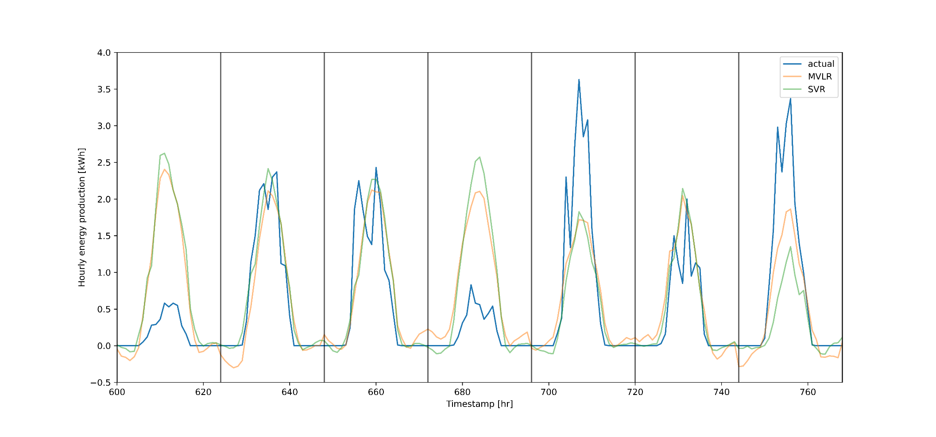
Energy Production
Machine Learning
MVLR, SVR

Slide 6
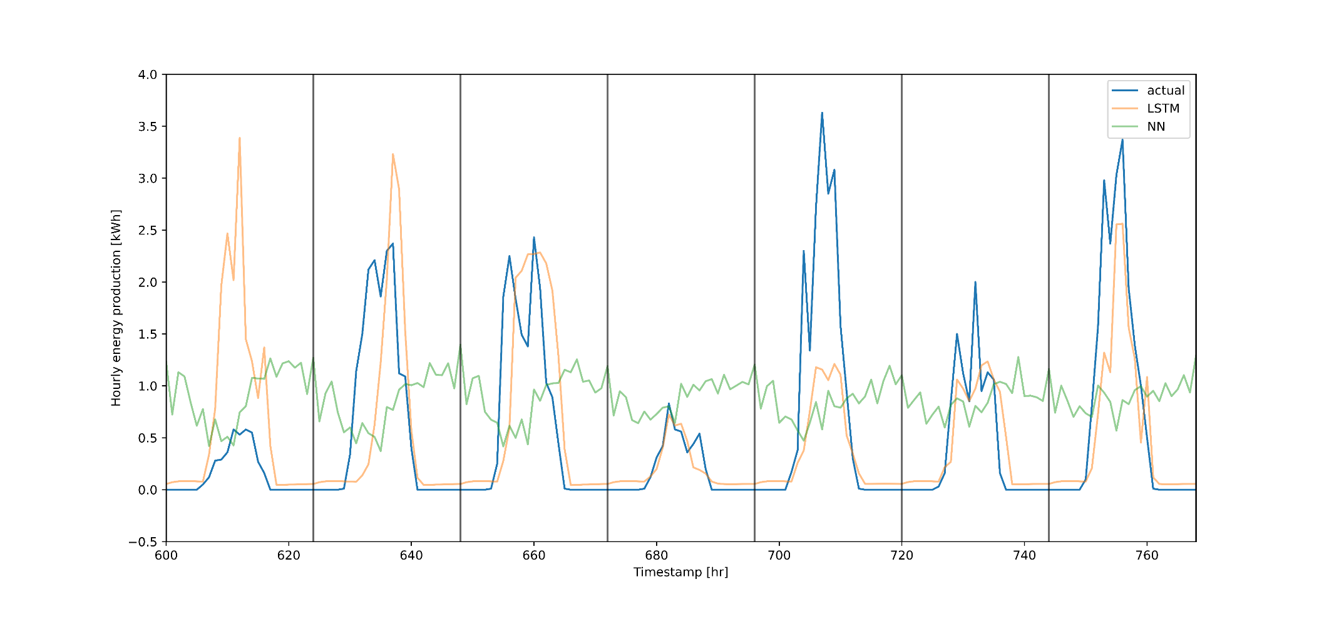
Energy Production
Neural Networks
LSTM, MLP

Slide 7
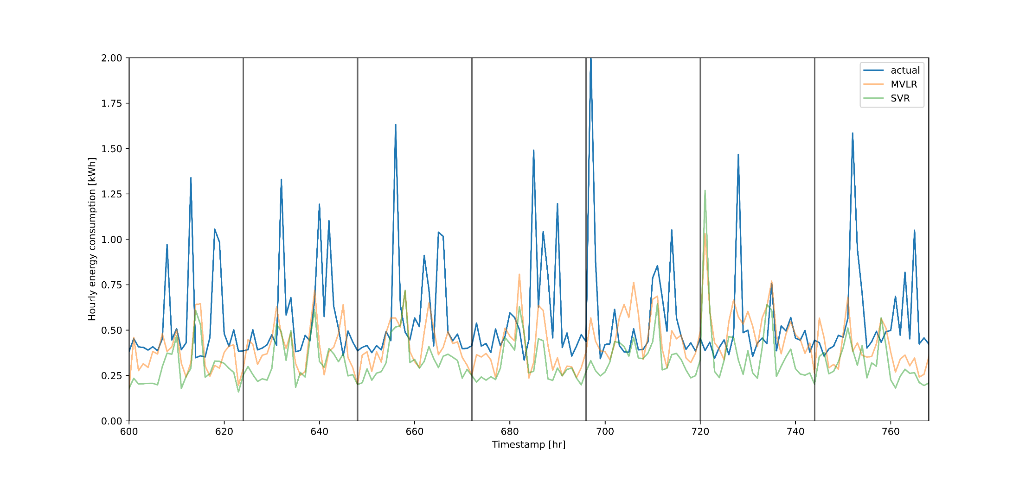
Energy Consumption
Machine Learning
MVLR, SVR

Slide 8
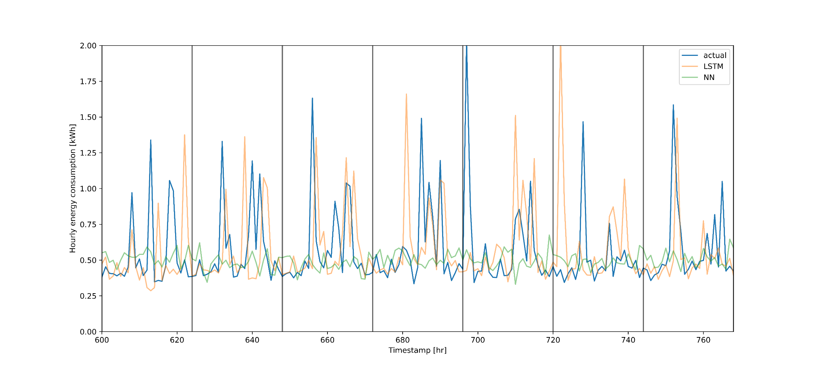
Energy Consumption
Neural Networks
LSTM, MLP

Slide 9
Conclusion
The LSTM model works best on both predicting consumption and production. This is due to it’s remembering capabilities. However, there is still room for improvements.

Slide 10

Remarks, Suggestions, Questions

